Slide 1

Optimizing Hospital Efficiency
Emergency Room Operations Dashboard Project using excel

Slide 2
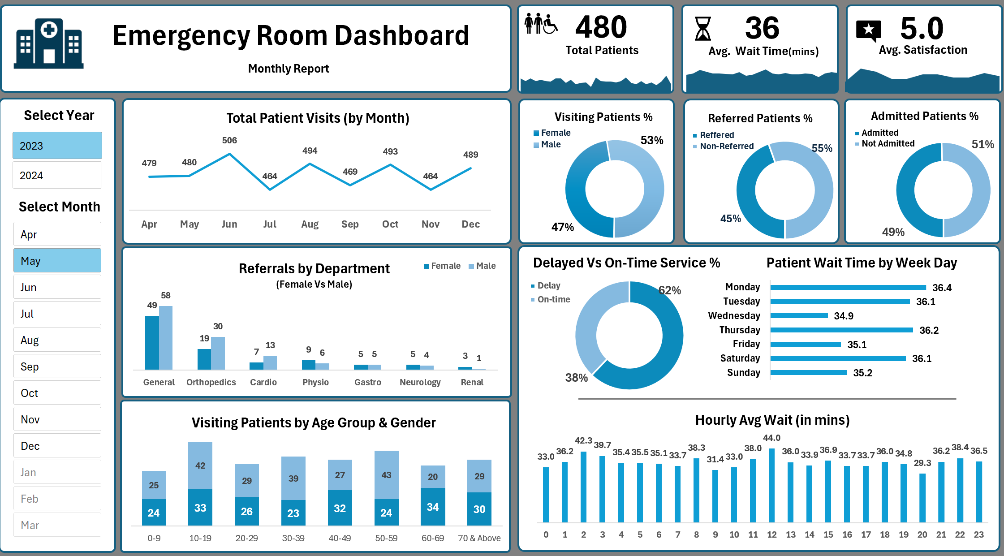
The Challenge: Turning Data into Action
Hospital emergency rooms are complex environments where managing patient flow, minimizing wait times, and ensuring high satisfaction are critical. This project's objective was to build a comprehensive, interactive dashboard in Excel to transform raw operational data into clear, actionable insights for hospital management.

Slide 3
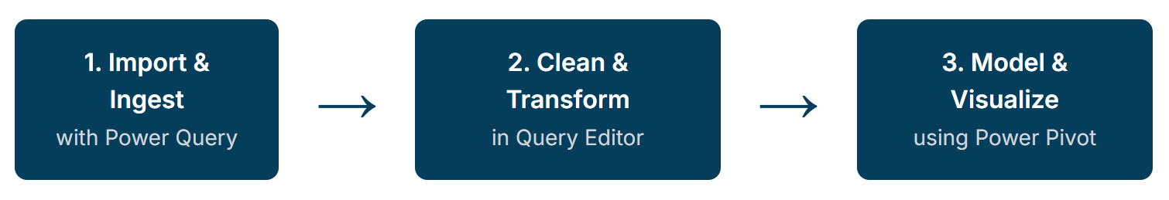
My Technical Journey
The foundation of this dashboard is a robust data pipeline built entirely within Excel, showcasing key data engineering and analysis skills.

Slide 4
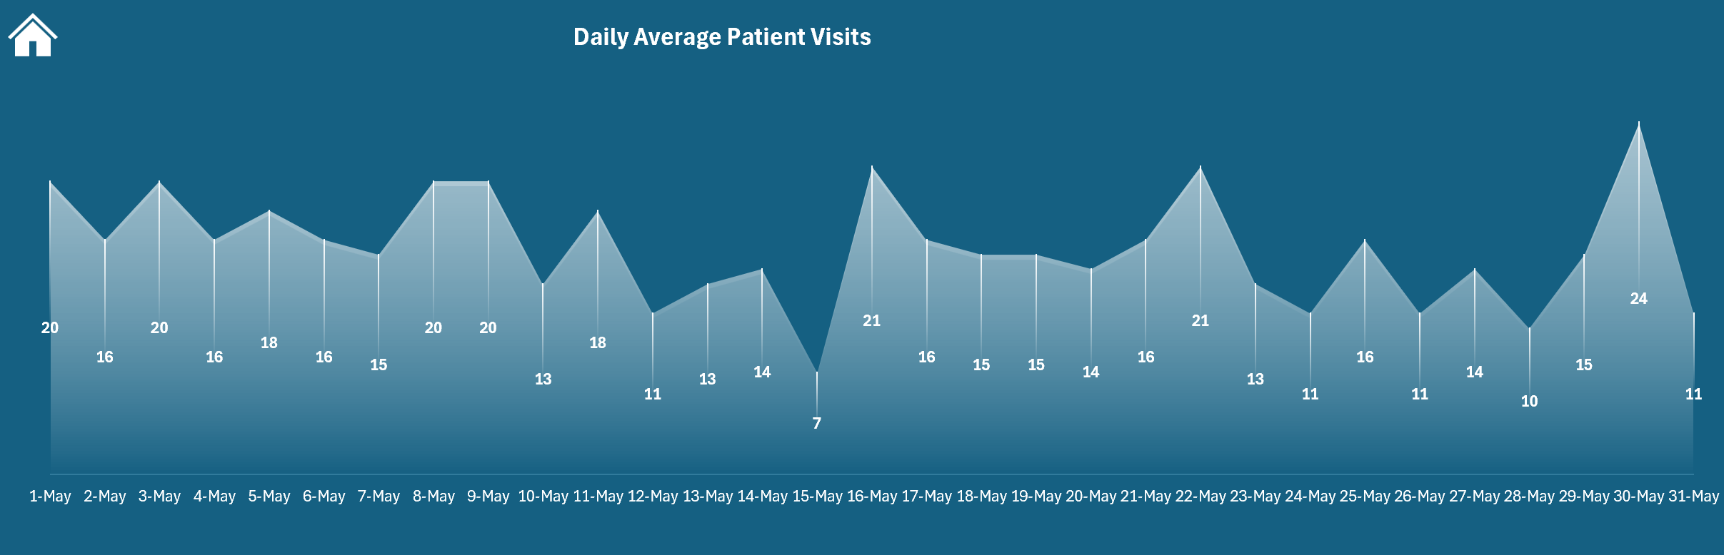
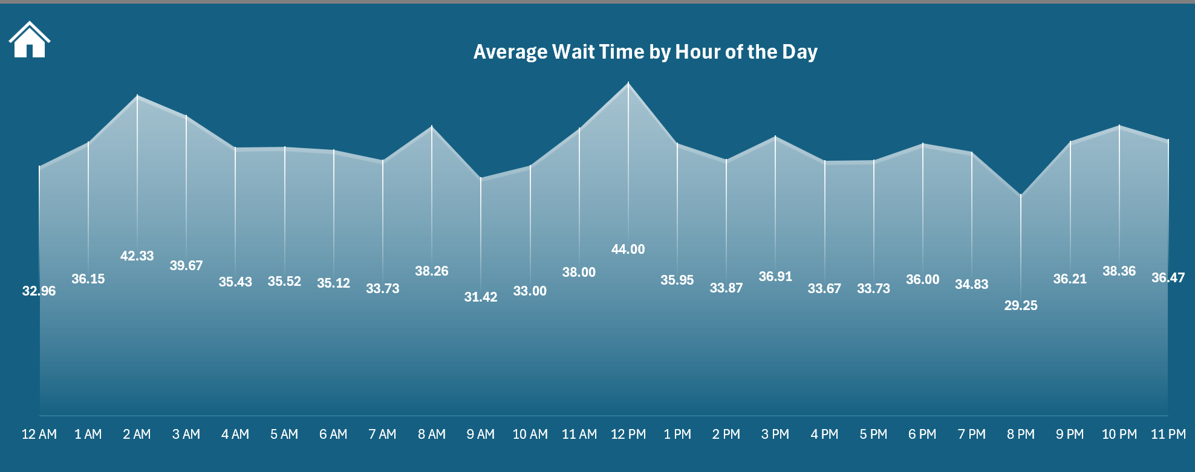
Key Insights for Hospital Management
Monthly Patient Visits Analysis - Understanding patient visit trends throughout the year is crucial for strategic resource planning and budgeting. This chart reveals the seasonal flow of patient demand.
Who Are Our Patients? - The dashboard provides a clear breakdown of patient demographics. In May, there was a slightly higher percentage of female patients, a key insight for departments that cater to gender-specific health issues.
Operational Efficiency - Timeliness of service is a major factor in patient satisfaction. With 62% of services marked as delayed, this metric signals a clear opportunity for process improvement and bottleneck analysis.
Hourly Wait Time Analysis - The average wait time fluctuates significantly throughout the day. Identifying peak wait times, such as the spike to 44 minutes around noon, allows for targeted interventions like deploying additional staff or re-engineering triage processes during these critical hours.
Referrals by Department & Gender - This view highlights which departments receive the most referrals from the ER and shows the gender distribution within those referrals. The high volume to 'General' and 'Orthopedics' suggests these areas are primary downstream pathways from the ER.
Satisfaction Levels of Visiting Patients - Patient satisfaction isn't uniform across all age groups or patients who were referred from specific departments. For example, Satisfaction scores vary dramatically based on the department a patient is referred to. The high scores for 'Renal' and 'Physio' can be studied for best practices, while the low scores for 'Cardio' and 'Gastro' indicate areas needing immediate attention and process review.

Slide 5
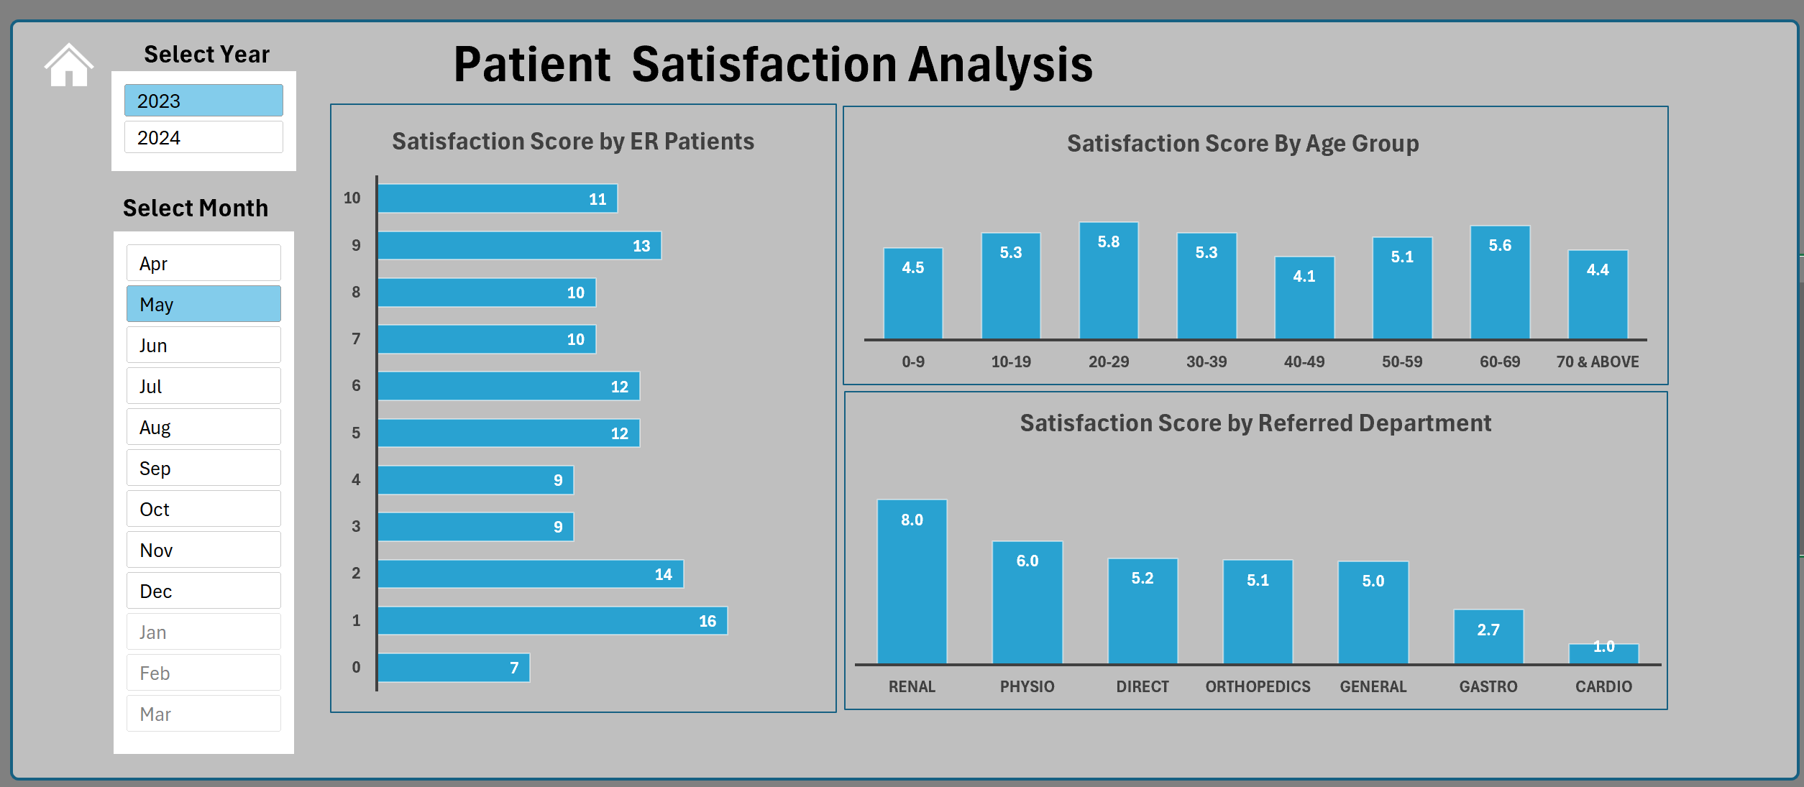
Key Insights for Hospital Management

Slide 6
Impact & Actionable Recommendations
Optimize Staffing: Use the hourly and daily patient flow data to create dynamic staffing schedules that align personnel with peak demand, especially around noon and on high-traffic days. | Improve Patient Experience: Investigate the low satisfaction scores in the 'Cardio' and 'Gastro' referral pathways, as well as for patients in the 40-49 and 70+ age brackets, to identify and address root causes.
Streamline High-Volume Pathways: Focus process improvement efforts on the 'General' and 'Orthopedics' referral departments, as they handle the largest volume of patients from the ER. | Address Service Delays: With 62% of services experiencing delays, a hospital-wide initiative to identify and eliminate operational bottlenecks is highly recommended to improve both efficiency and patient satisfaction.

